Slide 1


DISTRIBUTED COMPUTING
Sunita Mahajan, Principal, Institute of Computer Science, MET League of Colleges, Mumbai
Seema Shah, Principal, Vidyalankar Institute of Technology, Mumbai University

Slide 2
Chapter - 7
Distributed Shared Memory

Slide 3
Topics
Introduction
Basic concepts of DSM
Hardware DSM
Design issues in DSM
Issues in implementing DSM systems
Heterogeneous and other DSM systems
Case Study

Slide 4
Introduction

Slide 5
IPC paradigms
Message passing
Shared memory
Multi computer systems are easier to build but harder to program while multiprocessor systems are complex to build but easier to program
Distributed Shared Memory systems (DSM) are both easy to program and easy to build

Slide 6
Basic Concepts Of DSM

Slide 7
DSM
A DSM system provides a logical abstraction of shared memory which is built using a set of interconnected nodes having physically distributed memories.

Slide 8
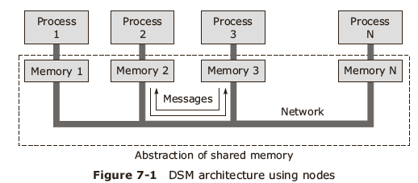
DSM architecture-1
DSM:
  Ease of programming and portability
  Scalable with very high computing power

Slide 9
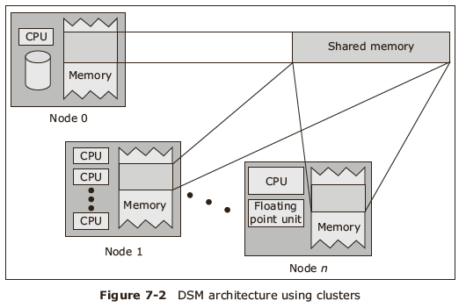
DSM architecture-2
Cluster based architecture

Slide 10
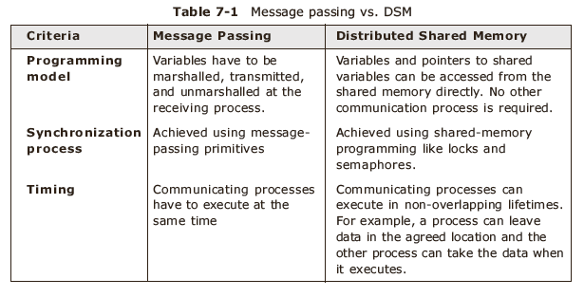
Comparison of IPC paradigms

Slide 11
Types of DSMs
Hardware level DSM
Software level DSM
Hybrid level DSM

Slide 12
Hardware level DSM
Smaller unit of sharing
HDSM is used where performance is more important than cost
Not scalable to more than 10 systems

Slide 13
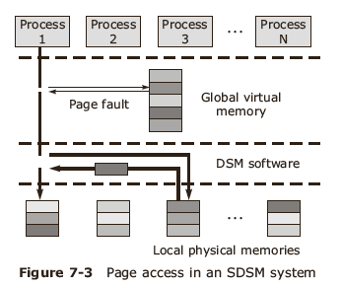
Software level DSM
SDSM can be implemented where compiler detects shared accesses and inserts call to synchronization routines into executable code.

Slide 14
Hybrid level DSM
Lies between HDSM and SDSM
Eg NUMA(Non uniform memory access)

Slide 15
Advantages of DSM
Simple abstraction
Improved portability of distributed application programs
Provides better performance in some applications
Large memory space at no extra cost
Better than message passing systems

Slide 16
Hardware DSM

Slide 17
Hardware architectures
On chip memory
Bus based multiprocessor
Ring based multiprocessor
Switched multiprocessor

Slide 18
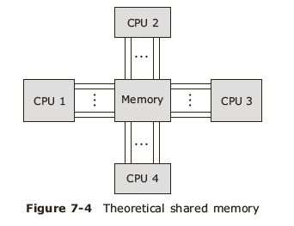
On chip memory
- The address and data lines are directly connected from all CPU to single shared memory
- Very Expensive and practically impossible

Slide 19
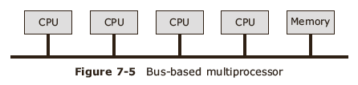
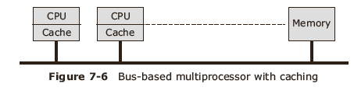
Bus based multiprocessor
Use bus arbitration mechanism

Slide 20
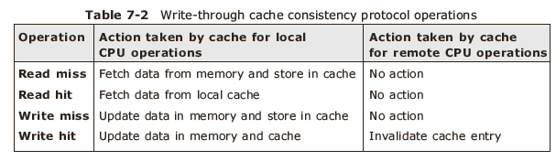
Consistency protocols

Slide 21
Cache consistency protocol
Properties:
  Consistency is achieved since all caches do us snooping
  Protocol is built into MMU
  The algorithm is performed in one memory cycle

Slide 22
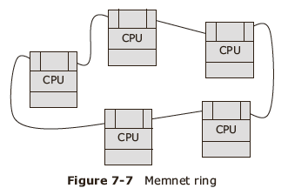
Ring based Multiprocessor are implemented in Memnet DSM
Single shared
Memory is divided
  Private areas
  Shared areas

Slide 23
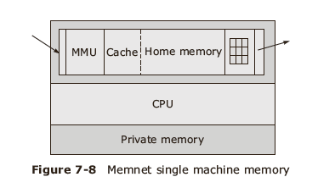
Memnet: Node memory

Slide 24
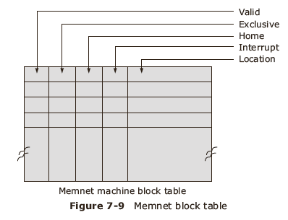
Valid – bit tells Whether block is
Present in cache
Exclusive bit tells whether it is local copy
Or only copy
Home bit is set if it is data blocks home
Machine
Interrupt is used to force interrupts
Location field tells whether block is locate d in cache
And whether it is present and valid

Slide 25
Comparison
The major difference between bus based and ring based multiprocessors is that the former are tightly coupled while the latter are loosely coupled.
Ring based multiprocessors are almost hardware implementation of DSM.

Slide 26
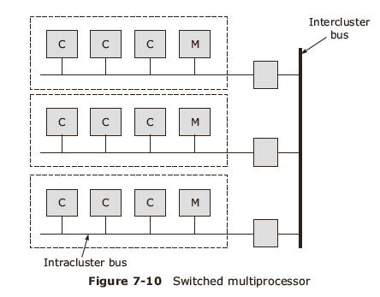
Switched multiprocessor
Multiple clusters interconnected by a bus offer better scalability
Example : Dash system

Slide 27
Design Issues In DSM

Slide 28
DSM design issues
Granularity of sharing
Structure of data
Consistency models
Coherence protocols

Slide 29
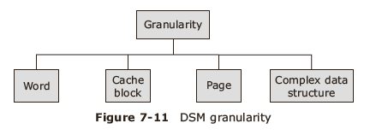
Granularity
False sharing
Thrashing

Slide 30
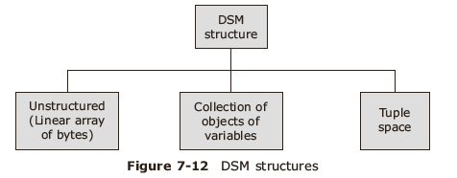
DSM structure
Organization of data items in the shared memory

Slide 31
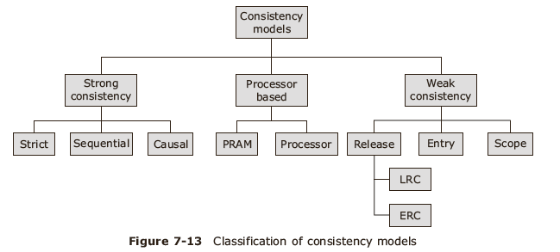
Consistency models
Refers to how recent the shared memory updates are visible to all the other processes running on different machines

Slide 32
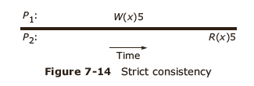
Strict consistency
Strongest form of consistency

Slide 33
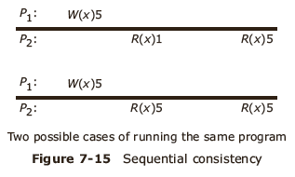
Sequential consistency
All processors in the system observe the same ordering of reads and writes which are issued in sequence by the individual processors

Slide 34
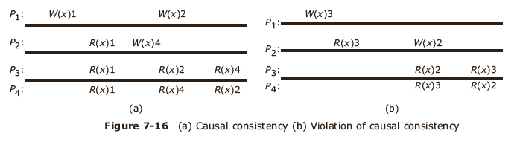
Causal consistency
Weakening of sequential consistency for better concurrency
Causally related operation is the one which has influenced the other operation

Slide 35
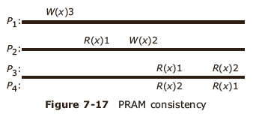
PRAM consistency
Pipelined Random Access Memory consistency
Write operations performed by a single process are seen by all other processes in the order in which they were performed just as if these write operations were performed by a single process in a pipeline.
Write operations performed by different processes may be seen by different processes in different orders.

Slide 36
Processor consistency
Adheres to the PRAM consistency
Constraint on memory coherence
Order in which the memory operations are seen by two processors need not be identical, but the order of writes issued by each processor must be preserved

Slide 37
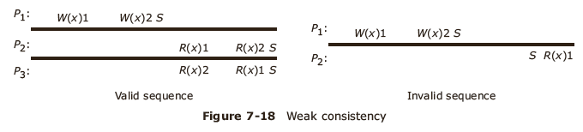
Weak consistency
Use a special variable called the synchronization variable

Slide 38
Properties of the weak consistency model
Access to synchronization variables is sequentially consistent
Only when all previous writes are completed everywhere, access to synchronizations variable is allowed
Until all previous accesses to synchronization variables are performed, no read write data access operations will be allowed.

Slide 39
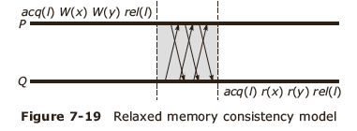
Release consistency
Synchronization variables: acquire and release
Use barrier mechanism

Slide 40
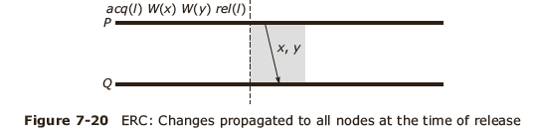
Eager Release Consistency

Slide 41
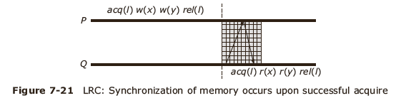
Lazy Release Consistency

Slide 42
Entry consistency
Use acquire and release at the start and end of each critical section, respectively.
Each ordinary shared variable is associated with some synchronization variable such as a lock or barrier.
Entry consistency (EC) is similar to LRC but more relaxed; shared data is explicitly associated with synchronization primitives and is made consistent when such an operation is performed

Slide 43
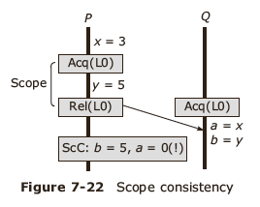
Scope consistency
A scope is a limited view of memory with respect to which memory references are performed

Slide 44
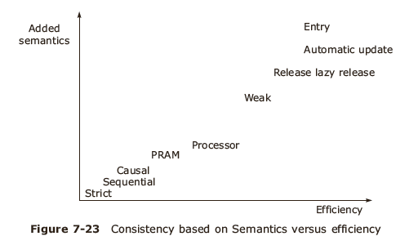
Comparison of consistency models-1
Most common: sequential consistency model

Slide 45
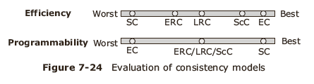
Comparison of Consistency models-2
Based on efficiency and programmability

Slide 46
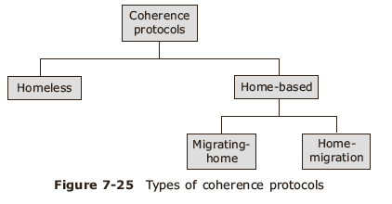
Coherence protocols
Specifies how the rules set by the memory consistency model are to be implemented

Slide 47
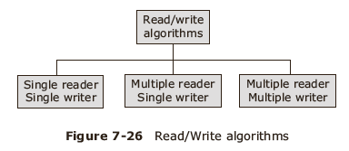
Coherence algorithms
Maintain consistency among replicas

Slide 48
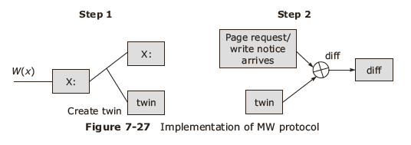
Multiple Reader/ Multiple Writer algorithm
Uses twin and diff creation technique

Slide 49
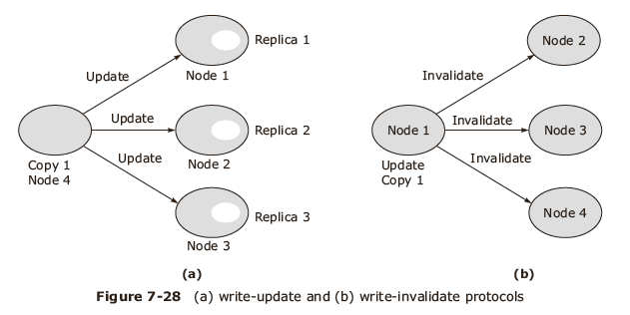
Write Protocols for consistency
Write Update (WU)
Write Invalidate (WI) protocols

Slide 50
Issues In Implementing DSM Systems

Slide 51
Issues
Thrashing
Responsibility of DMS management
Replication v/s migration
Replacement strategy

Slide 52
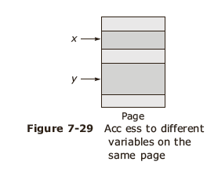
Thrashing
False sharing
Techniques to reduce thrashing:
  Application controlled lock
  Pin the block to a node for specific time
  Customize algorithm to shared data usage pattern

Slide 53
Responsibility for DSM management
Algorithms for data location and consistency management:
  Centralized manager algorithm
  Broadcast algorithm
  Fixed Distributed manager algorithm
  Dynamic distributed manager algorithm

Slide 54
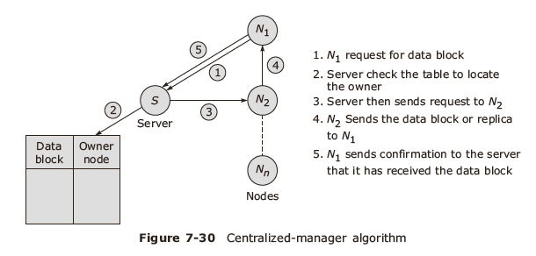
Centralized Manager algorithm

Slide 55
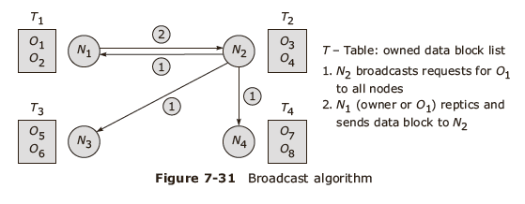
Broadcast algorithm
Replicates

Slide 56
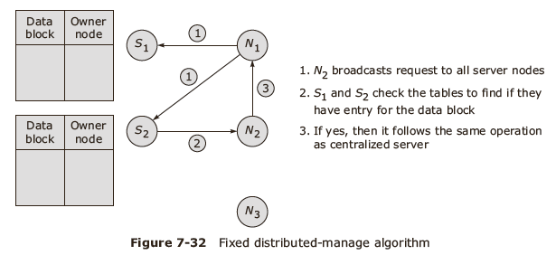
Fixed Distributed manager algorithm

Slide 57
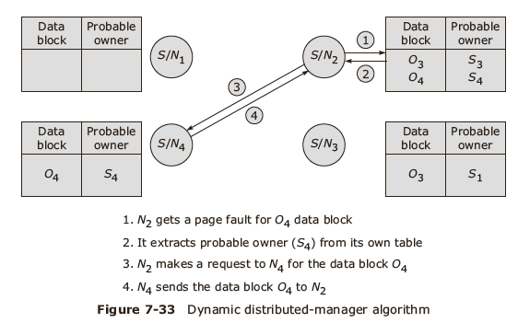
Dynamic distributed manager algorithm

Slide 58
Replication versus migration strategies
Replication strategy:
  No replication
  Replication
Migration strategy
  No migration
  Migration
Non Replicated and Non Migrating Block- NRNMB
Non Replicated, Migrating Block- NRMB
Replicated, Migrating Block- RMB
Replicated Non Migrating Block-RNMB

Slide 59
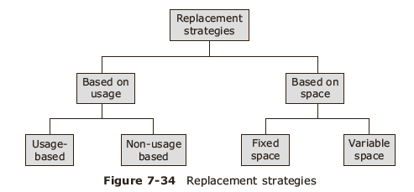
Replacement strategy

Slide 60
Heterogeneous And Other DSM Systems

Slide 61
Issues in building Heterogeneous DSM systems
Data compatibility and conversion
  DSM as a collection of source language objects
Block size selection
  Largest page size
  Smallest page size
  Intermediate page size

Slide 62
Approaches to DSM design
Based on data caching management DSM is managed by:
  Operating system
  MMU Hardware
  Language runtime system

Slide 63
Case Study

Slide 64
Case studies
Munin
Linda
Teamster
JUMP

Slide 65
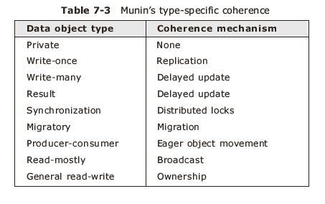
Munin

Slide 66
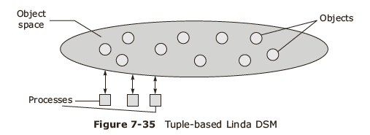
Linda-1

Slide 67
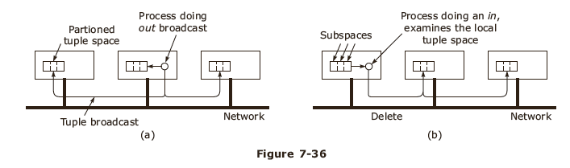
Linda-2

Slide 68
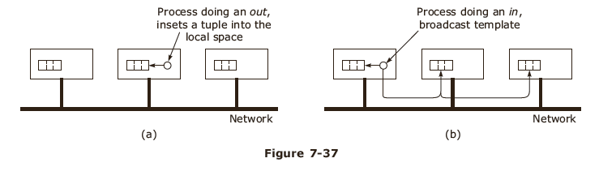
Linda-3

Slide 69
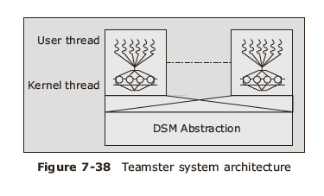
Teamster-1

Slide 70
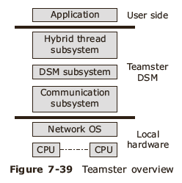
Teamster-2

Slide 71
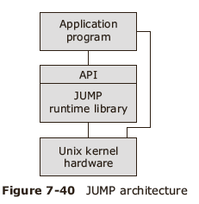
JUMP-1

Slide 72
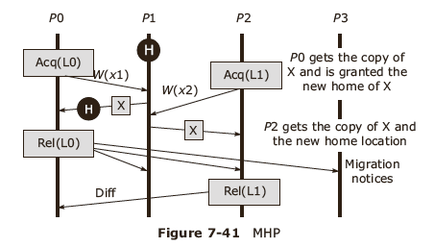
JUMP-2
Migrating Home Protocol

Slide 73
Summary
Introduction
Basic concepts of DSM
Hardware DSM
Design issues in DSM
Issues in implementing DSM systems
Heterogeneous and other DSM systems
Case Study

